Slide 1
Vending Machine!
Thomas Haimes

Slide 2
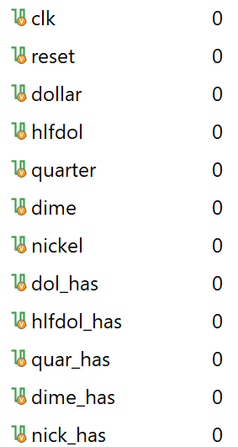
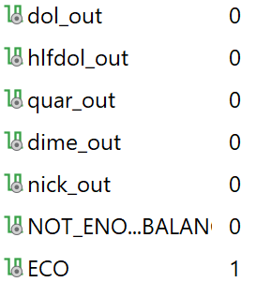
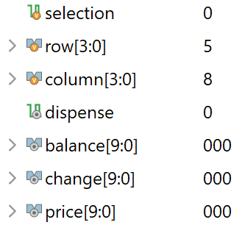
Variable List

Slide 3
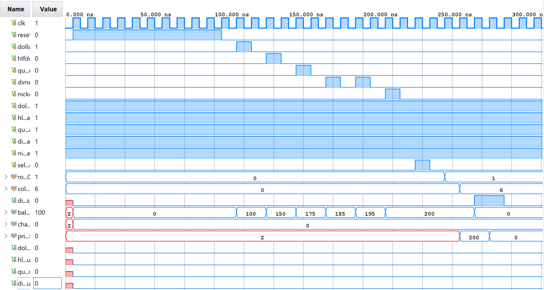
Exact Amount (NO CHANGE)

Slide 4
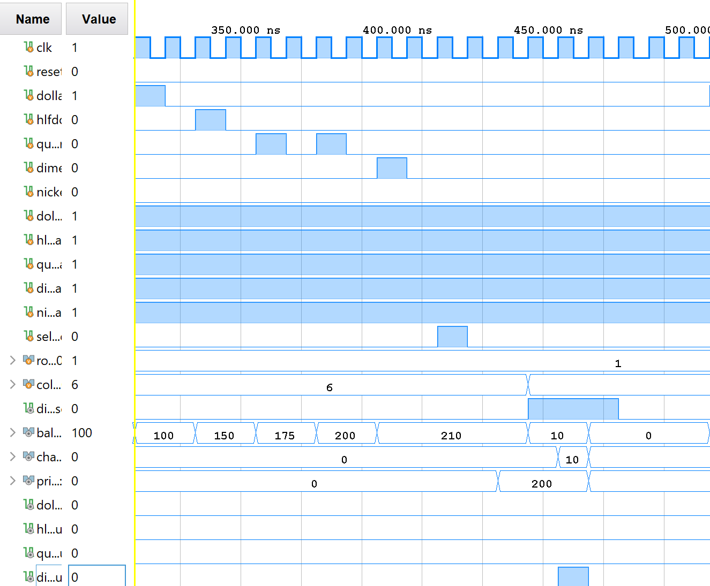
A little bit of change (1 dime)
Single dime output as change

Slide 5
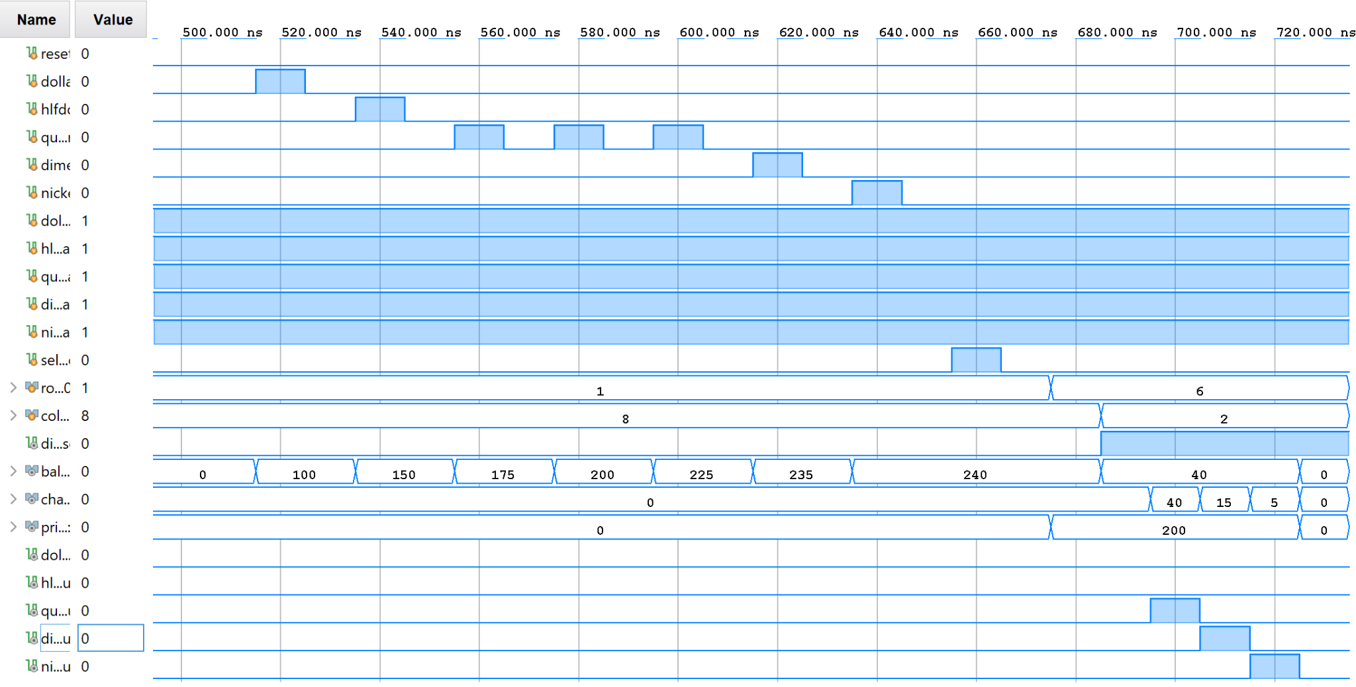
A little more change (1 quarter + 1 dime + 1 nickel)
Multiple coin output one at a time
Same clock

Slide 6
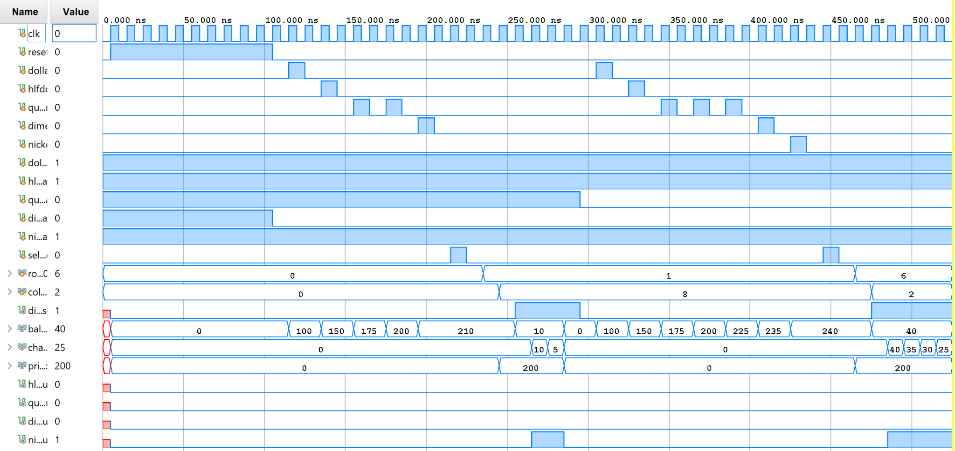
Change w/ Missing Coins

Slide 7
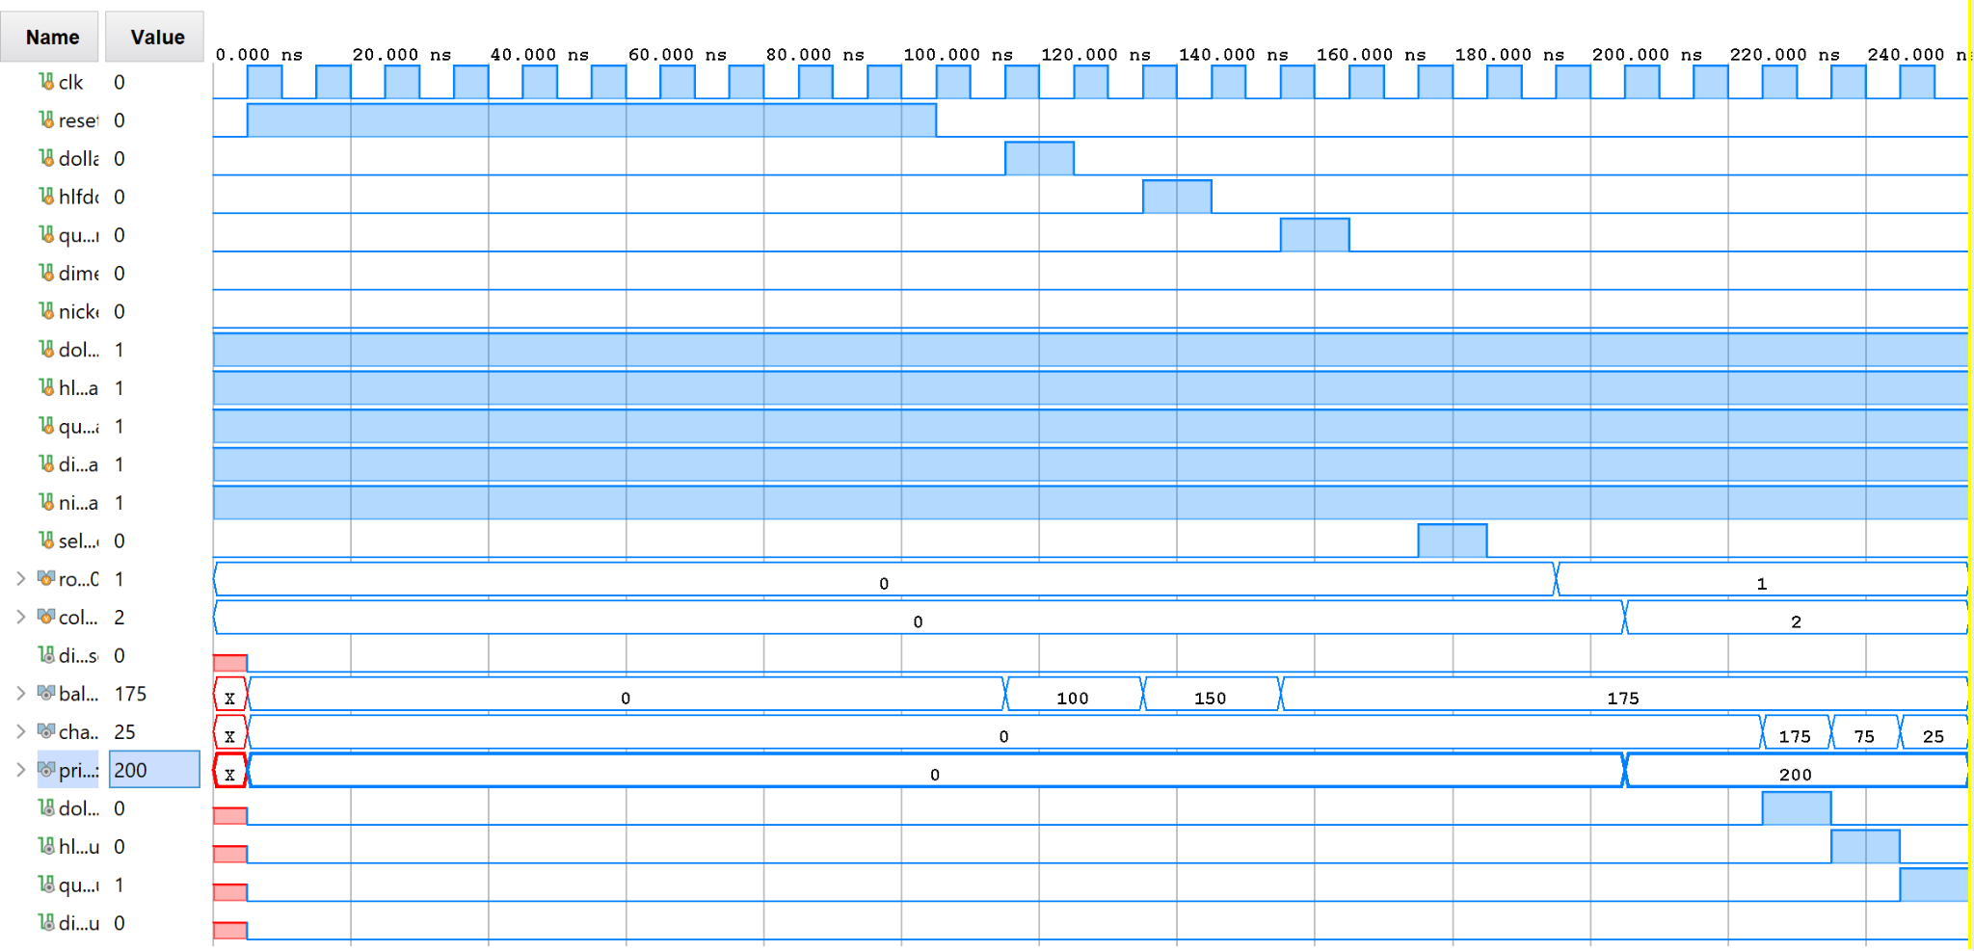
You’re Broke

Slide 8
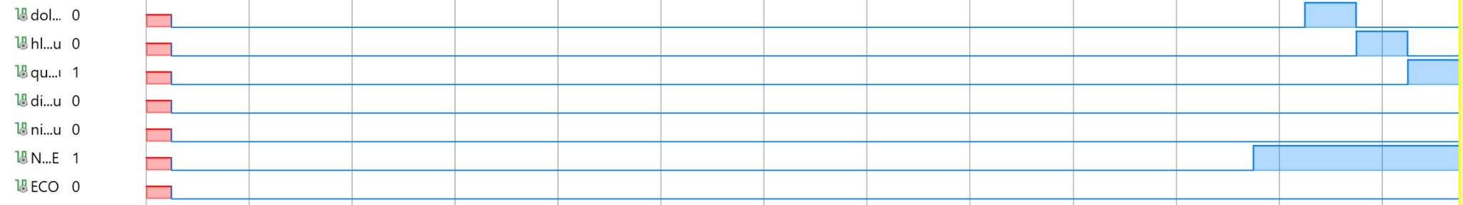
Not Enough Money Flag Tripped

Slide 9
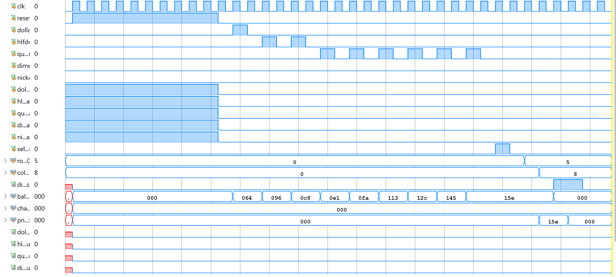
Exact Change Only Mode

Slide 10
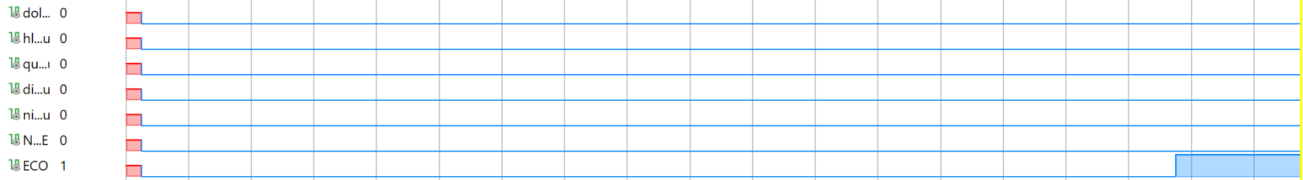
Exact Change Only Flag Tripped
Your money will be eaten in this mode it will not be given back.
In the vending industry we call this the “you gave us money?” mode!

